Slide 1
ELDERCare Super APP
A Unified Platform for Bangladesh's Elderly Crisis

Slide 2
TEAM MEMBERS
Saif Khan
2022-2-60-063
Abrar Hossain Zahin
Md. Minhajul Haque Shafin
2022-2-60-063
2022-2-60-063
Nelufa Yeasmin
Faisal Ahmed
2022-2-60-063
2022-2-60-063

Slide 3
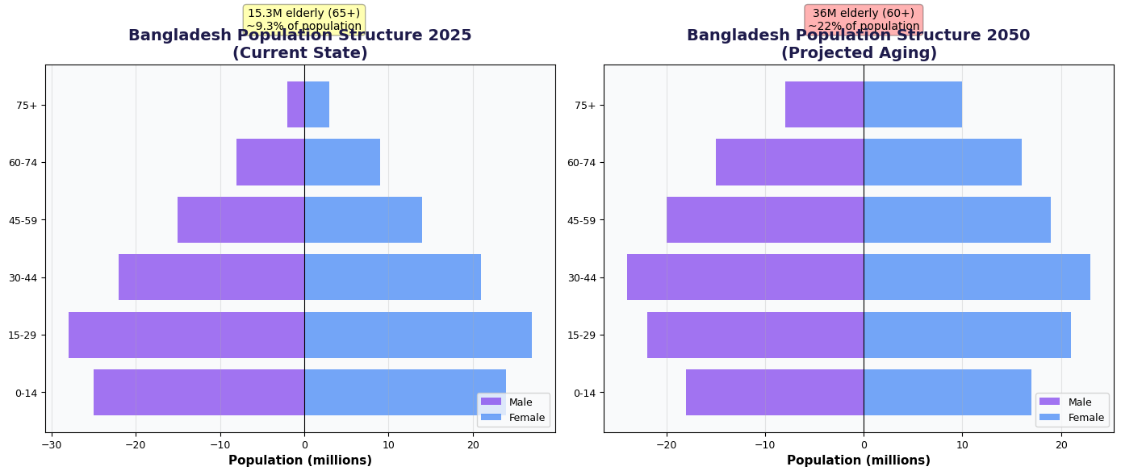
The Critical Challenge
15.3 million elderly citizens (65+) today
22% of population will be 60+ by 2050
95% face health complications
55.5% of Bangladesh remains offline
41% report fragmented care coordination
Only 27.3% receive old age allowance

Slide 4
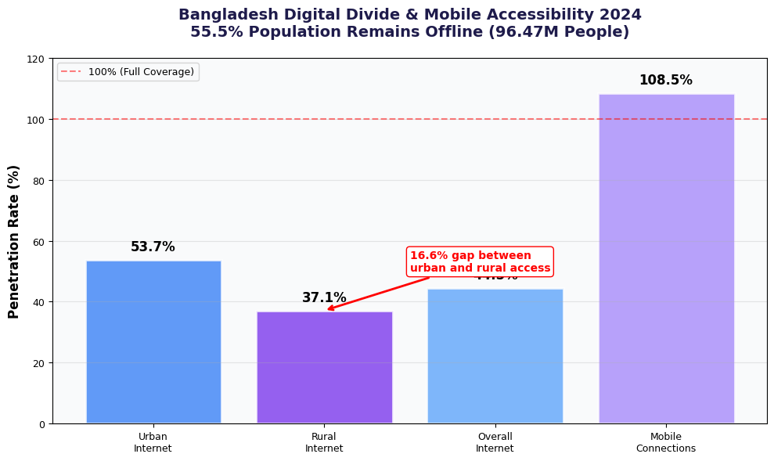
The Critical Challenge
15.3 million elderly citizens (65+) today
22% of population will be 60+ by 2050
95% face health complications
55.5% of Bangladesh remains offline
41% report fragmented care coordination
Only 27.3% receive old age allowance

Slide 5
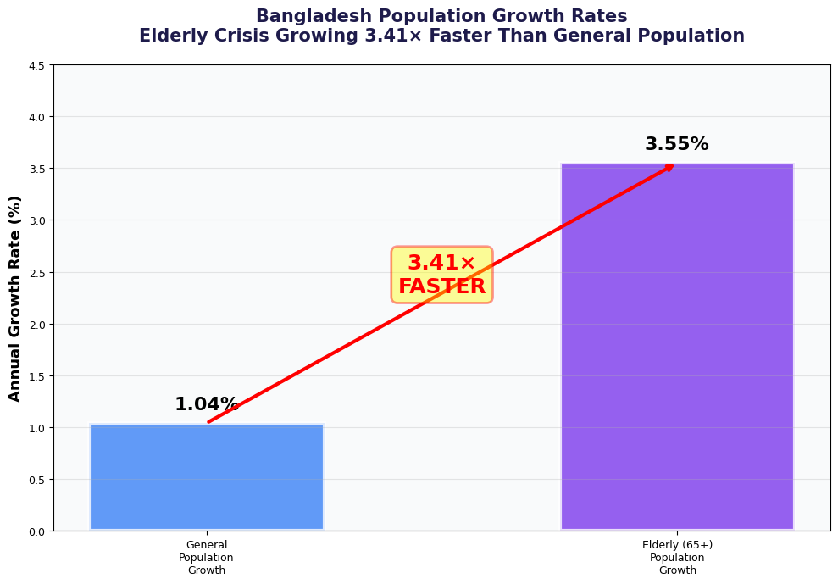
The Critical Challenge
15.3 million elderly citizens (65+) today
22% of population will be 60+ by 2050
95% face health complications
55.5% of Bangladesh remains offline
41% report fragmented care coordination
Only 27.3% receive old age allowance

Slide 6
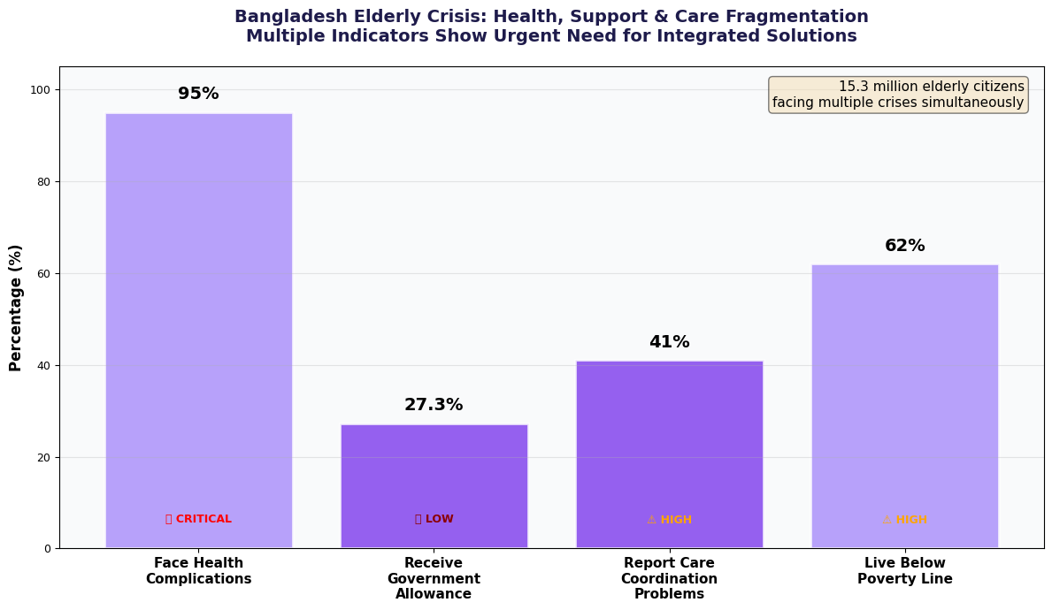
The Critical Challenge
15.3 million elderly citizens (65+) today
22% of population will be 60+ by 2050
95% face health complications
55.5% of Bangladesh remains offline
41% report fragmented care coordination
Only 27.3% receive old age allowance

Slide 7




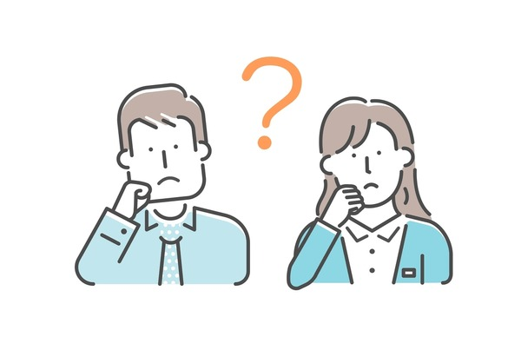




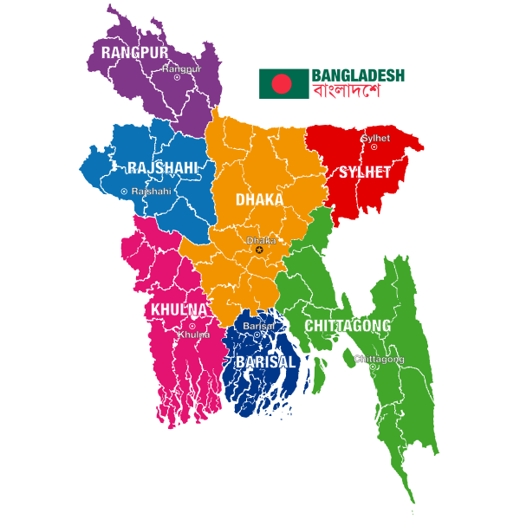


The Pain Points & Our Solution
The Fragmentation Problem
Multiple disconnected apps
No family oversight
Not Bangladesh-ready
Higher mortality risk

Slide 8
The Pain Points & Our Solution
Our Unified Solution
9 integrated modules
in ONE platform
Role System
Bangladesh-first design
Gamification & rewards for engagement
Cross-module intelligence (health data → nutrition)

Slide 9
The Pain Points & Our Solution
Our Unified Solution
9 integrated modules
in ONE platform
Role System
Bangladesh-first design
Gamification & rewards for engagement
Cross-module intelligence (health data → nutrition)

Slide 10
The Pain Points & Our Solution
Our Unified Solution
9 integrated modules
in ONE platform
AgeWell
Care360
SilverBox
Role System
GoldenCare
Bangladesh-first design
ElderCare
ElderLink
Gamification & rewards for engagement
NutriSensor
Cross-module intelligence (health data → nutrition)
Reward
TeleHealth
Community

Slide 11
Key Requirements & Features
Functional Requirements
Real-Time Family Monitoring Dashboard
Authentication
Nine Core Modules
Multi-Role Architecture
Unified Notification & Alert System

Slide 12
Key Requirements & Features
Housing & accommodation discovery/service for ageing population
Comprehensive health-record management, medication tracking, and family monitoring
Care360
AgeWell
Smart health box: reminders, IoT monitoring (BP, glucose, activity)
SilverBox
Employment/new-purpose opportunities for older adults
GoldenCare
Nine Core Modules
Social networking and peer-community for seniors
ElderLink
Nutrition planning and meal-services tailored for senior health profiles
NutriSensor
Gamified incentives, points, redemption for participation and healthy behavioral tasks
Reward
Video/voice consults + remote monitoring integration
TeleHealth
Community
Local event/meet-ups, neighborhood groups, volunteering coordination

Slide 13
Key Requirements & Features
Non-Functional Requirements
Security & Privacy Compliance
Localization & Market Fit
Performance & Connectivity Optimization
Accessibility & Senior-First UX
Scalability & Modular Architecture
Availability & Operational Excellence

Slide 14
Stakeholders
Primary
Senior
Family Member/ Care Takes of Elders
Healthcare Provider

Slide 15
Stakeholders
Secondary
Government
Healthcare institution
Eldercare market access
Smart Bangladesh 2041 vision
Reduce fragmented care
Local businesses
Employers
Active aging workforce

Slide 16
Value Proposition & Success Criteria
SUCCESS CRITERIA
VALUE PROPOSITION
LONG-TERM VISION
ONLY all-in-one eldercare platform in Bangladesh
50,000+ users onboarded
70%+ daily active rate
40% better medication adherence
85%+ family satisfaction
60% more social engagement
3.41× faster performance
50% less app-switching (9 apps to 1)
30% lower total cost
Real-time family monitoring
100% localized (BDT, time zone, culture)
Serve 3.6M+ seniors nationwide
Partner with 500+ healthcare orgs
Break-even by Month 18
99.9% uptime, <3 sec load time
Become Bangladesh’s national eldercare platform

Slide 17
Reference
Evidence-Driven Innovation, Built on Verified Research
Primary Data Sources:
Bangladesh Bureau of Statistics (BBS, 2024). Elderly Population and Demographics Report.
DataReportal (2024). Digital Bangladesh Overview: Internet and Mobile Penetration.
BMC Medicine Journal (2023). Fragmented Care and Its Impact on Elderly Mortality.
Frontiers in Digital Health (2023). Usability Barriers in Elderly Health App Adoption.
University of Dhaka, Department of Public Health (2024). National Elderly Health Complications Study.
World Health Organization (WHO, 2023). Health System Efficiency Indicators for South Asia.
Government of Bangladesh (2013). National Policy for Older Persons.
Ministry of ICT, Smart Bangladesh Vision 2041 (2024). Policy Framework for Digital Inclusion.
Market and Technology Insights:
Fortune Business Insights (2024). Global Eldercare Market Forecast 2024–2030.
Statista (2024). Healthcare App Engagement Metrics and Cost Analysis.
ScienceDirect (2023). Technology Anxiety and Digital Literacy Among Seniors.
BMC Geriatrics (2023). Medication Adherence and Digital Monitoring Systems.
Internal Research and Validation:
Stakeholder Interviews: Senior citizens, family caregivers, and healthcare providers (2025).
Pilot User Testing Data: Unified dashboard prototype (v0.9) performance metrics.
Comparative Benchmarking: App-switching rate, uptime, and latency compared to existing market solutions.

Slide 18
Thank You
Any Question?

